Slide 1
Final Presentation
Pipelining data for future growth

Slide 2
What is Blockchain?

Slide 3


Slide 4
Users
Platforms
Companies

Slide 5
Users
Hackathons
Platforms
Companies

Slide 6




Slide 7
Problem
With an unstructured platform, how can TBC gather valuable information that could help them curate high-value interactions amongst their user groups?

Slide 8
Narrowing down the Problem
Platforms
Companies
70%
Of expected revenue
Base off TBC’s market potential research

Slide 9
Where should we start
Research
Reorganize
Retool

Slide 10
Research

Slide 11

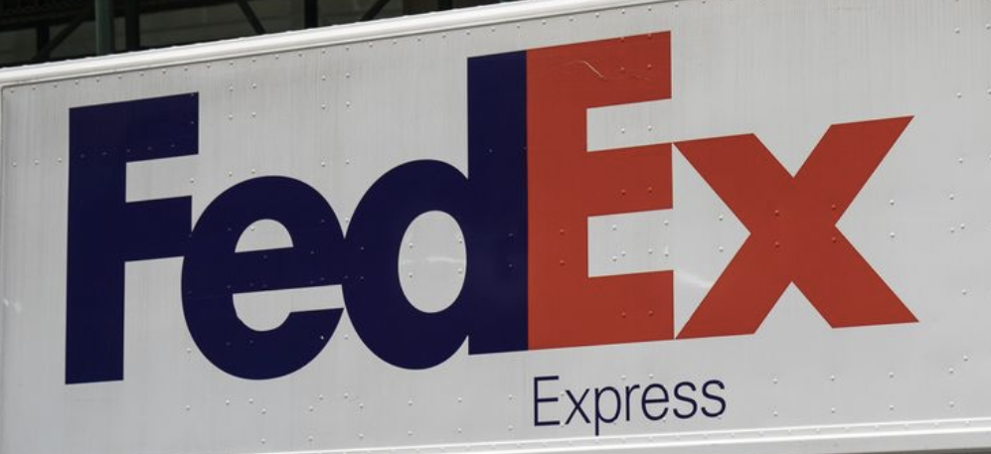
Research
Walmart Case Study [2] [3]
Based on blockchain verification mechanism and irreversible data record, Walmart launched Food Trust project with IBM and GS1 to solve information authentication problem.
Fedex Case Study
FedEx is seeking industry collaboration to use blockchain technology for more secure delivery service.
Notes:
As mentioned, we focused on the business side so we start with looking into some business case studies.
Walmart works with multiple parties such as IBM and GS1 to create a viable solution for information authentication problem.
And Fedex gets industry collaboration to bring up blockchain into their delivery service.
The blockchain industry needs cooperation between companies, but they still need to find the right parties to interact with.

Slide 12
Research
3. MedicalChain [4]
Built a decentralised platform that enables secure, fast and transparent usage of medical data.
4. TBC Hackathon - Hippocrate [5]
Hackathon solutions and the real-world practices share similar patterns. Companies which share similar use cases could learn from each other.
Notes:
How to find the right parties?
When we look into another two cases are MedicalChain project and a hackathon named Hippocrate created by TBC, we realized that these two projects all fit in the Healthcare industry and they solved the same problem with slightly different technology.
So companies might want to know when they face problems, what technology should they use and why.

Slide 13
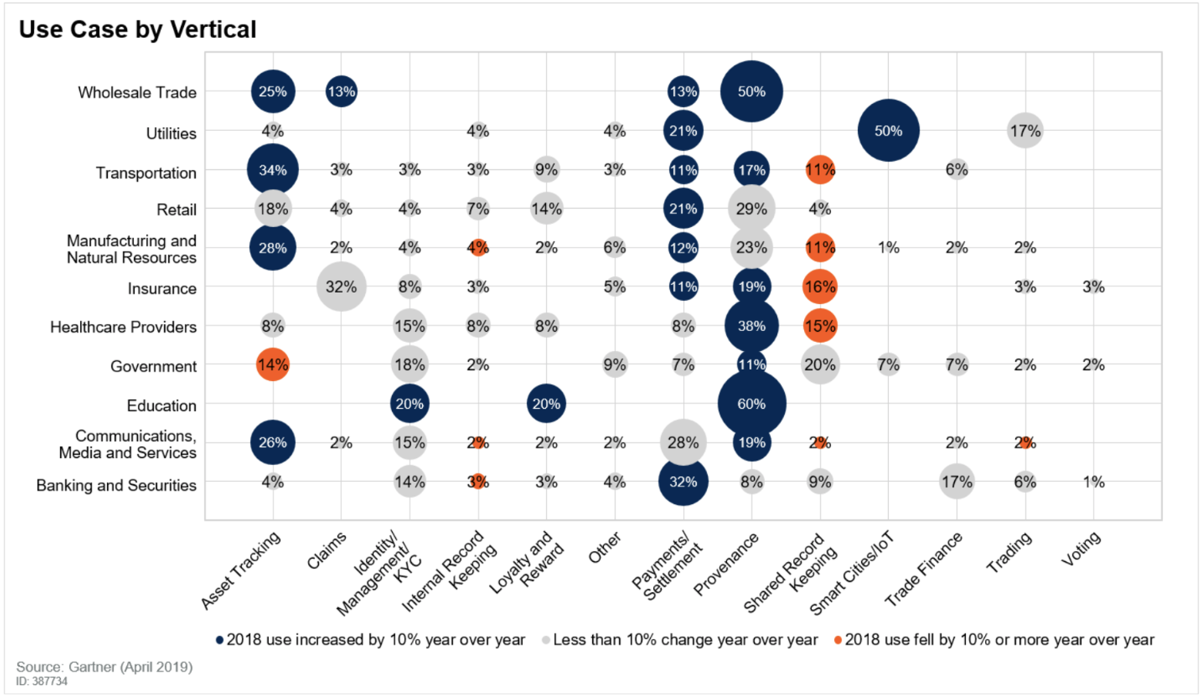
Vertical investigation in industry ^{[4]}
Notes:
How can we answer problems we derived from previous case studies?
We did further research into the industry, and found certain metrics released by companies to show which area blockchain are mostly used. But this picture is hard to see, so let’s just simplify into a little table.

Slide 14
Research - Use Case by Vertical
 | Provenance | Trading
Education | Growing | Not Growing
Insurance | Not Growing | Growing
Notes:
From this table we can see two problem types are on the top, and two industries are on the left side.
We could see that the popularity of blockchain problems in various categories are different, and actually some problems are better solved in certain industry compared to other problems, so companies might be interested in this kind of patterns, and these patterns are what we want to reflect through our current dataset within TBC.

Slide 15
Research
Lessons learned:
There are informative and valuable interactions among companies.
Projects can be broken down into categories.
Notes:
Now Let’s recap what we learned from our research:
First, Interactions between companies are important and they want to find the right parties to interact with.
Second, projects can be broken down into different problems types and categories, so companies should be interested in understand successful patterns.

Slide 16
Reorganize
Notes:
So how to restructure the internal data from TBC’s current two main channels, Slack and GitHub to answer those questions? Where do we start?
First, reorganization existing tools to fit in the patterns we mentioned above could be useful.

Slide 17
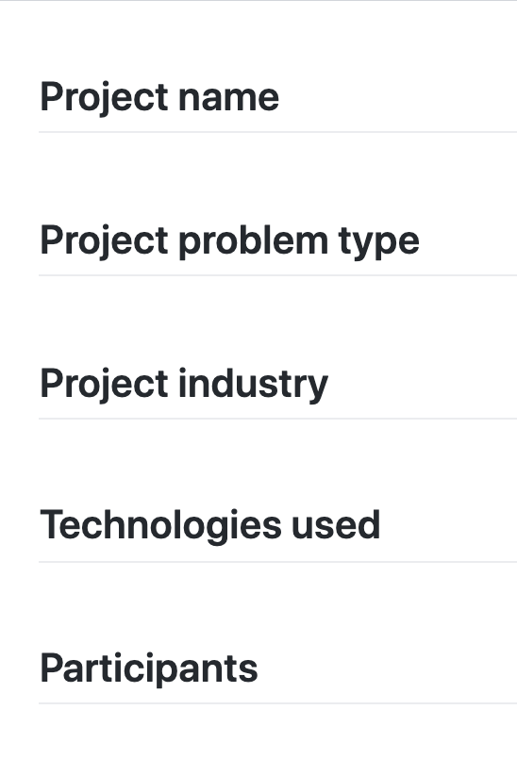
Reorganize
GitHub Readme File
Add structured headers to GitHub README.md files
Project name, problem type, industry, technologies, participants
Notes:
We suggest to add structured README files into each blockchain hackathon solutions.

Slide 18
Reorganize
Slack Channel
General hackathon channel for important notifications
Technology channel
Business channel
Notes:
Such reorganizations will help to answer the problems the companies would like to know and help to create more successful solutions.
After reorganization, the next step will be adding new tools to provide further information.

Slide 19
Retool

Slide 20
Slack Scanner

Slide 21
Retool - Slack Scanner
Token Management
Message Update
Search

Slide 22
Slack EndPoint
UserInfo:
ID
Name
Phone
Email
...
Messages:
ID
Text
Type
TimeStamp
User
...
Notes:
So with this tokens what do we intend to access

Slide 23
User Info
Slack EndPoint
Server
Messages
Document
MongoDB

Slide 24
MongoDB Document
Messages:
ID
TimeStamp
HackathonName
ChannelName
UserEmail
Text
Messages:
ID
TimeStamp
HackathonName
ChannelName
UserEmail
Text

Slide 25
GitHub Scanner

Slide 26
Retool - Github Scanner
Add Hackathons
Search
Reset Data

Slide 27
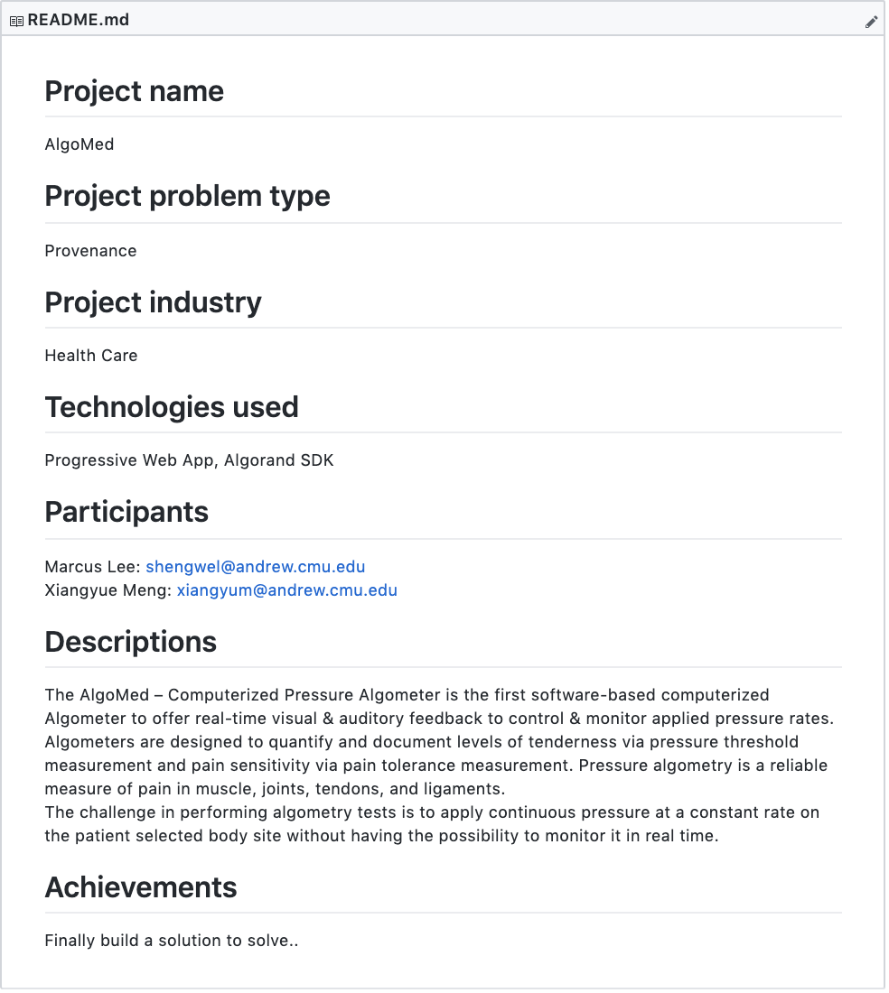
Retool - Github Scanner
Data Source: Structured ReadME file

Slide 28
Github Solution links
Github EndPoint
Server
Github Solution ReadME file
Document
MongoDB

Slide 29
MongoDB Document
Hackathon
Project:
ID
Hackthon_name
Project_name
Problem_type
Industry
Technology
Participants
File_extension
Project:
ID
Hackthon_name
Project_name
Problem_Type
Industry
Technology
Participants
File_extension

Slide 30
Demo

Slide 31
Future Improvements
Easing into Reorganization
Expanding to other channels of communication
Question Identification
Education

Slide 32
References
[1] T. Felin and K. Lakhani, “What Problems Will You Solve With Blockchain?,” MIT Sloan Management Review, 11-Sep-2018. [Online]. Available: https://sloanreview.mit.edu/article/what-problems-will-you-solve-with-blockchain/. [Accessed: 11-Oct-2019].
[2] “Walmart Case Study,” Hyperledger. [Online]. Available: https://www.hyperledger.org/resources/publications/walmart-case-study. [Accessed: 11-Oct-2019].
[3] “In Wake of Romaine E. coli Scare, Walmart Deploys Blockchain to Track Leafy Greens,” Corporate. [Online]. Available: https://corporate.walmart.com/newsroom/2018/09/24/in-wake-of-romaine-e-coli-scare-walmart-deploys-blockchain-to-track-leafy-greens. [Accessed: 11-Oct-2019].
[4] “Medichain,” Corporate. [Online]. Available: https://medicalchain.com/en/. [Accessed: 11-Oct-2019].
[5] “Hippocrates,” Corporate. [Online]. Available: https://devpost.com/software/hippocrates-ldwftv. [Accessed: 11-Oct-2019].

Slide 33
Questions

